Slide 1
Predicting Obesity Levels Based on Eating Habits and Physical Conditions
DATASET: Classification Dataset
COURSENAME : Machine Learning
DATE : October 24th , 2024
Golola Charles 2024/HD05/21923U 2400721923
Raphael Abila 2024/HD05/21912U 2400721912

Slide 2
Abstract
Obesity is a global health issue, associated with severe medical complications such as diabetes, hypertension, and cardiovascular diseases.
Through a comparative analysis of models such as Decision Trees, Support Vector Machines, and Neural Networks, we demonstrate the potential of machine learning to predict obesity levels with high accuracy.

Slide 3
Introduction
Obesity affects millions of individuals worldwide and has far-reaching health, social, and economic consequences.
Traditional methods of obesity estimation rely on manual calculations and expert assessments.
This study focuses on developing models that use attributes like dietary habits, physical activity levels, and demographic information to estimate obesity levels.

Slide 4
Background and Motivation
Obesity is influenced by various factors, including diet, physical activity, and genetics.
The health sector initiatives often struggle to address these factors collectively due to limitations in manual data analysis
Machine learning provides tools to analyze multiple factors simultaneously, enabling precise obesity classification
Rising obesity rates in countries like Mexico, Peru, and Colombia highlight the urgent need for scalable solutions

Slide 5
Problem Statement
Obesity has become a global health crisis.
Despite the problem, there is a lack of comprehensive models that can predict obesity levels.
Hence, a need to develop a machine learning-based model to classify individuals into various obesity levels (underweight, normal weight, overweight, and obese) using demographic, dietary, and physical condition data

Slide 6
Literature Review
Obesity Disease Risk Prediction Using Machine Learning. Focused on predicting obesity risk using ML algorithms, emphasizing the global health implications of obesity and its association with various diseases
This did not consider the application of these models within specific populations or regions.
The Role of Machine Learning in Obesity Prediction Across Latin American Countries. Only Focuses on dietary patterns and physical activity.
Systematic Review of Machine Learning Applied to the Prediction of Obesity and Overweight. This article has a global Inclusion

Slide 7
Dataset Description
Source: UC Irvine https://archive.ics.uci.edu/dataset/544/estimation+of+obesity+levels+based+on+eating+habits+and+physical+condition
Our dataset contains 17 attributes related to eating habits, physical activity, and demographics, with 2111 records.
Feature | Description
Gender
Age
Height
Weight
family_history_with_overweight | Has a family member suffered or suffers from overweight?
FAVC | Do you eat high caloric food frequently?

Slide 8
Dataset Description
FCVC | Do you usually eat vegetables in your meals?
NCP | How many main meals do you have daily?
CAEC | Do you eat any food between meals?
SMOKE | Do you smoke?
CH2O | How much water do you drink daily?
SCC | Do you monitor the calories you eat daily?
FAF | How often do you have physical activity?
TUE | How much time do you use technological devices such as cell phone, videogames, television, computer and others?
CALC | How often do you drink alcohol?
MTRANS | Which transportation do you usually use?
NObeyesdad | Obesity level

Slide 9
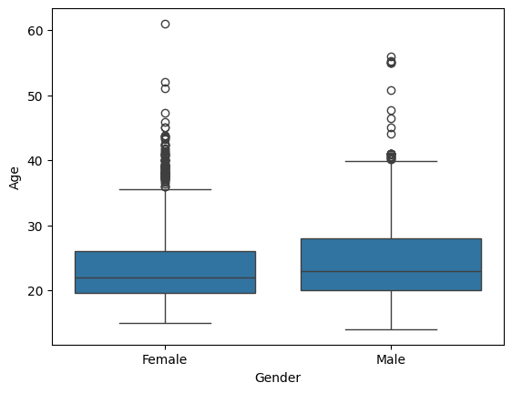
Methodology
1. Data cleaning
Checking for duplicates
- No duplicates
Filling missing values.
Normalizing numerical fields.
Outliers

Slide 10
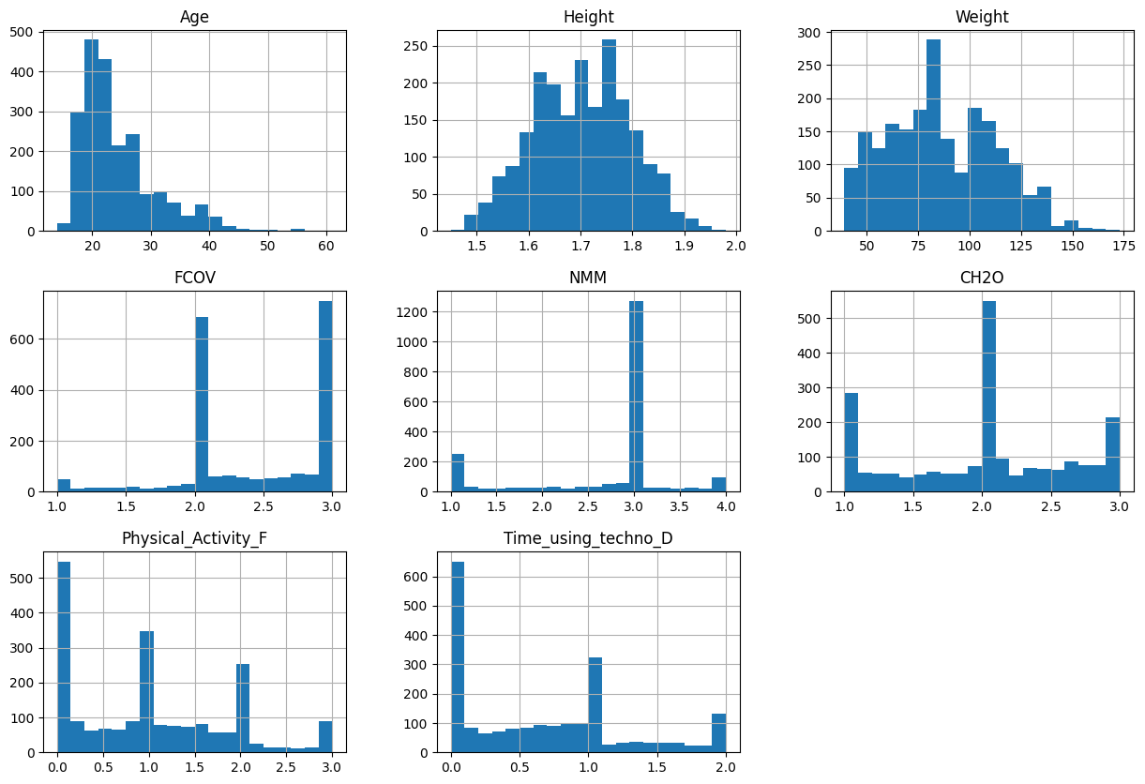
Cont.
2. EDA
Univariate Analysis

Slide 11
Cont.
Findings
we have maximum number of people between age range of 20-30.
Physical activity frequency is varying with very less people working out daily.
more than 1200 people prefer three main meals.
Frequency of consumption of vegetables is high.

Slide 12
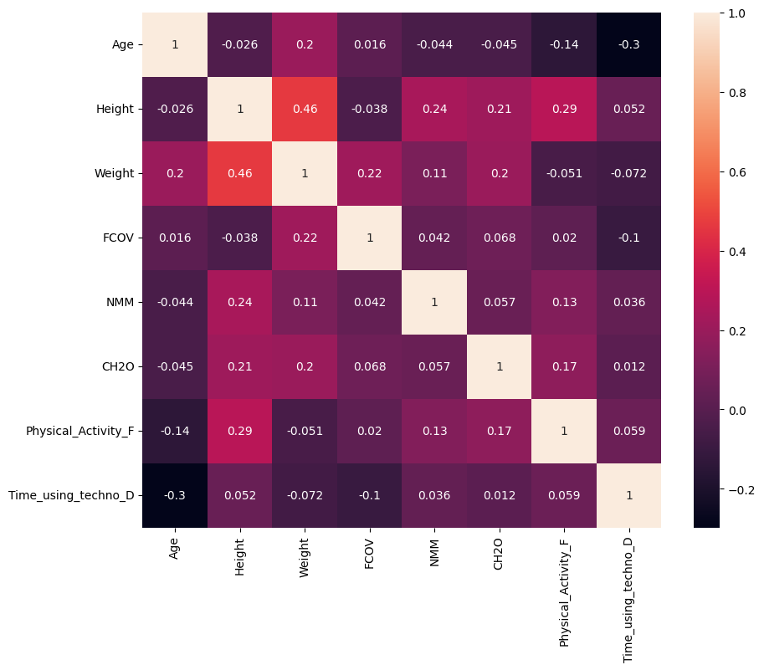
Cont.
b) Bivariate Analysis

Slide 13
Dataset Splitting:
The cleaned and balanced dataset was split into training, and testing sets in a 70:15:15 ratio.
This split ensured the model had enough data for training while retaining other data for validation and testing.

Slide 14
ML Model Selection and Optimization
Logistic Regression
Decision Tree
Support Vector Classification
Random Forest

Slide 15
Accuracy Scores
Model | Testing Accuracy
Logistic Regression | 0.89
Decision Tree | 0.77
Support Vector Classifier | 0.91
Random Forest | 0.96

Slide 16
Classification Report Metrics (Weighted Average for All Classes)
Model | Class 0 | Class 1 | Class 2 | Class 3 | Class 4 | Class 5 | Class 6
Logistic Regression | Precision: 0.89 | Precision: 1.00 | Precision: 0.91 | Precision: 0.91 | Precision: 1.00 | Precision: 0.76 | Precision: 0.79
 | Recall: 1.00 | Recall: 0.84 | Recall: 0.91 | Recall: 1.00 | Recall: 1.00 | Recall: 0.78 | Recall: 0.74
 | F1-Score: 0.94 | F1-Score: 0.92 | F1-Score: 0.91 | F1-Score: 0.95 | F1-Score: 1.00 | F1-Score: 0.77 | F1-Score: 0.76
Decision Tree | Precision: 0.88 | Precision: 0.78 | Precision: 0.89 | Precision: 0.82 | Precision: 1.00 | Precision: 0.54 | Precision: 0.60
 | Recall: 0.89 | Recall: 0.55 | Recall: 0.60 | Recall: 0.95 | Recall: 1.00 | Recall: 0.59 | Recall: 0.85
 | F1-Score: 0.88 | F1-Score: 0.65 | F1-Score: 0.72 | F1-Score: 0.88 | F1-Score: 1.00 | F1-Score: 0.56 | F1-Score: 0.70
Support Vector Classifier | Precision: 0.92 | Precision: 0.94 | Precision: 0.97 | Precision: 0.95 | Precision: 1.00 | Precision: 0.70 | Precision: 0.84
 | Recall: 0.96 | Recall: 0.81 | Recall: 0.95 | Recall: 1.00 | Recall: 1.00 | Recall: 0.82 | Recall: 0.80
 | F1-Score: 0.94 | F1-Score: 0.87 | F1-Score: 0.96 | F1-Score: 0.98 | F1-Score: 1.00 | F1-Score: 0.75 | F1-Score: 0.82
Random Forest | Precision: 0.96 | Precision: 0.92 | Precision: 0.97 | Precision: 1.00 | Precision: 1.00 | Precision: 0.92 | Precision: 0.94
 | Recall: 1.00 | Recall: 0.93 | Recall: 0.95 | Recall: 0.98 | Recall: 1.00 | Recall: 0.92 | Recall: 0.94
 | F1-Score: 0.98 | F1-Score: 0.92 | F1-Score: 0.96 | F1-Score: 0.99 | F1-Score: 1.00 | F1-Score: 0.92 | F1-Score: 0.94

Slide 17
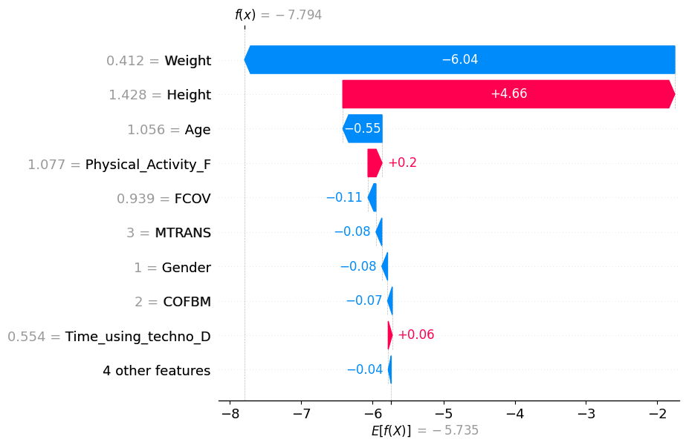
Explainable AI – ‘Shap’ (Logistic Regression)

Slide 18
Observations
Weight (-6.04):
This is the most significant feature contributing negatively to the model's prediction for this instance, reducing the predicted value by 6.04 units.
Height (+4.66): The second most impactful feature, contributing positively to the prediction, increasing the value by 4.66 units.

Slide 19
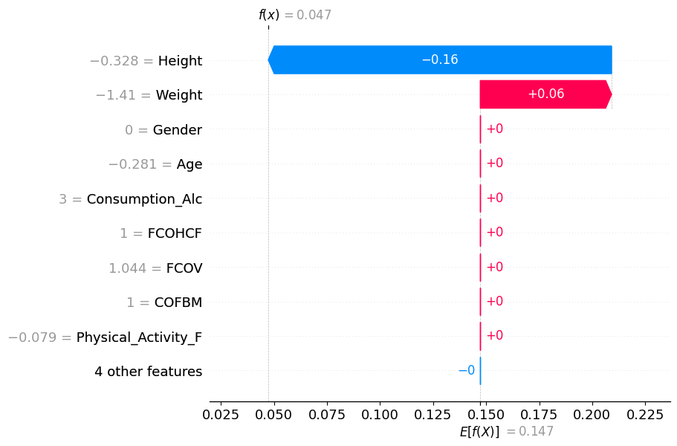
Shap explanation of Class 2
(Normal Weight)

Slide 20
Conclusion
Random Forest is the best model. The strongest performer across all metrics.
Consistently high precision, recall, and F1-scores for all classes.
No significant weaknesses, making it the most balanced and robust model

